Slide 1
BigData Analysis Using Hadoop
BY,
R.VENKATESH..

Slide 2
What is big data ?
Big data is a term that describes the large volume of data – structured , unstructured and semi structure.
There are 5vs of big data.

Slide 3
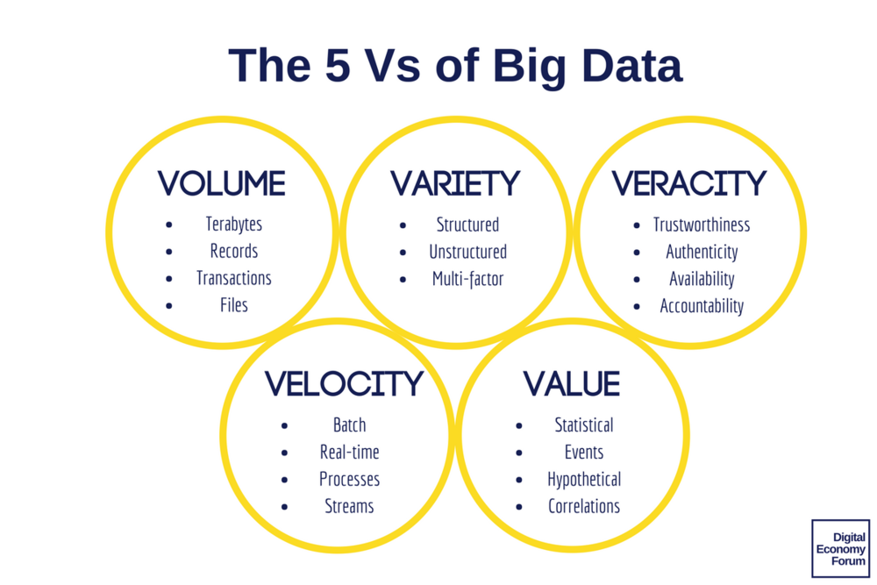
5v’s of bigdata:

Slide 4
Hadoop:
Hadoop is an open-source software framework.
It is devoloped by Doug Cutting in 2006.
It is used to store process and analyze data which are very huge in volume.

Slide 5
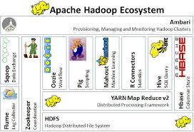
HADOOP ECOSYSTEM:

Slide 6
Hadoop Architecture:
Hadoop Distributed File System (HDFS™): A distributed file system that provides high-throughput access to application data.
MapReduce: MapReduce is a programming model suitable for processing of huge data.

Slide 7

Hdfs Architecture:

Slide 8
Hdfs :architecture works on master slave architecture.
Namenode: The namenode acts as the master server.It executes file system operations such as renaming, closing, and opening files and directories.
Datanode : Datanodes perform read-write operations on the file systems, as per client request.
Block : Each block is about 128 mb.

Slide 9
MAP REDUCE:
The MapReduce algorithm contains two important tasks, namely Map and Reduce.
Map takes a set of data and converts it into another set of data, where individual elements are broken down into tuples (key/value pairs).
Reduce task, which takes the output from a map as an input and combines those data tuples into a smaller set of tuples.

Slide 10
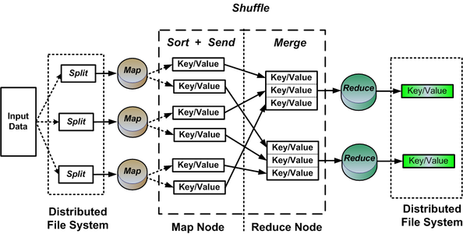
MAPREDUCE ARCHITECTURE:

Slide 11
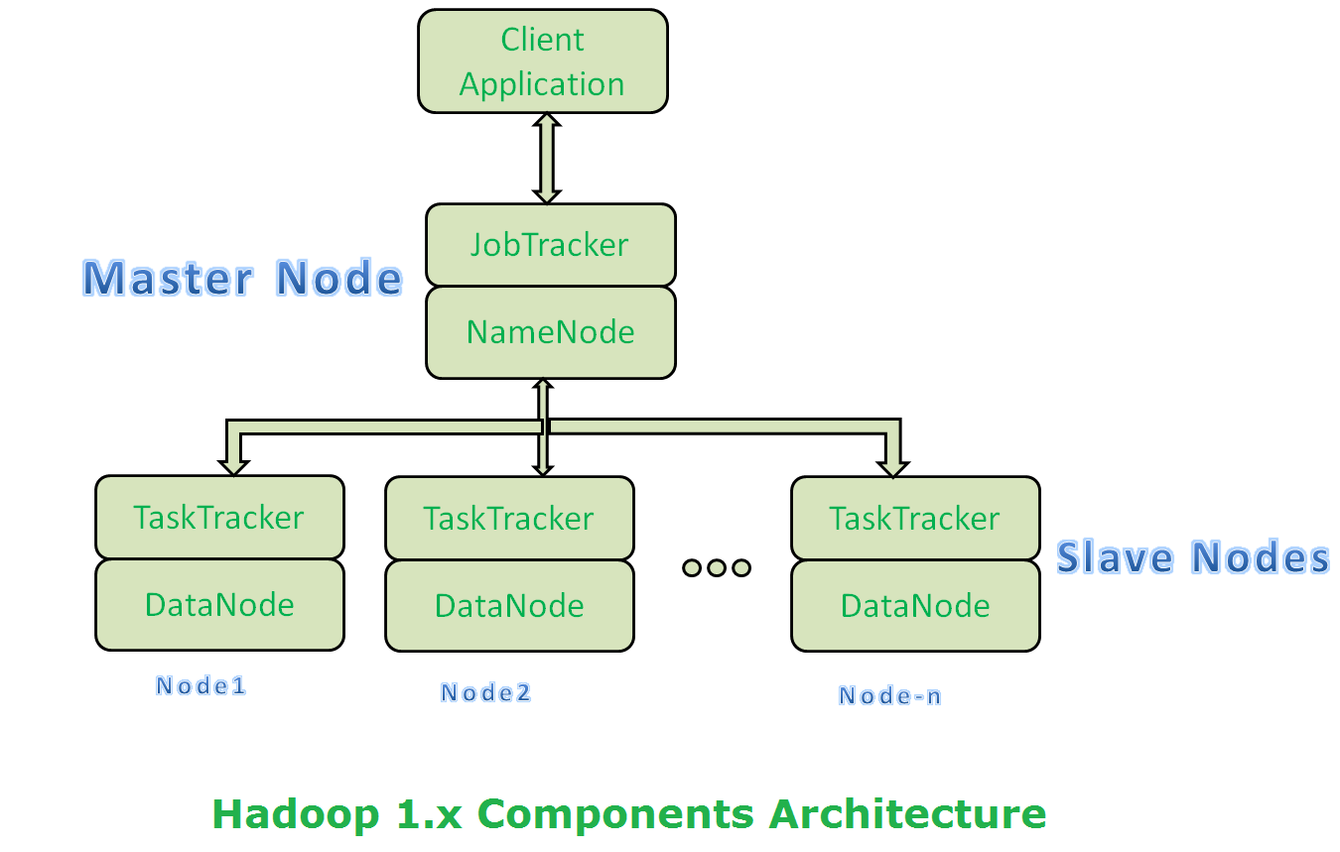
Hadoop architecture-1:

Slide 12
Hadoop architecture-1:
Job tracker - JobTracker is a master which creates and runs the job.
Task tracker - TaskTrackers run the tasks and report the status of task to JobTracker.
Name node - Stores metadata of the files.
Data node – Stores the actual data in Hdfs

Slide 13
HIVE:
Hive is a data warehouse infrastructure tool to process structured data in Hadoop.
It Supports SQL like query language for interaction and for Data modeling.
HiveQL also allows users to embed their custom map-reduce scripts.

Slide 14
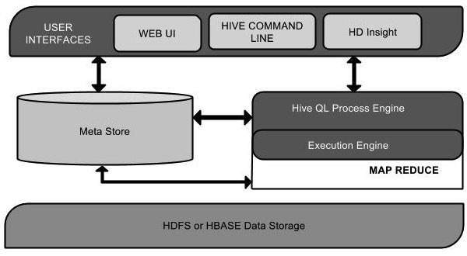
HIVE ARCHITECTURE:

Slide 15
Hive architecture:
User Interface: The user interfaces that Hive supports are Hive Web UI, Hive command line, and Hive HD Insight.
Meta Store: Hive chooses respective database servers to store databases and hdfs mapping.
HDFS or HBASE: the data storage techniques to store data into file system.

Slide 16
PIG:
It is a tool/platform which is used to analyze larger sets of data representing them as data flows.
Apache Pig is a data flow language.
It is a highlevel data processing language which provides a rich set of data types and operators to perform various operations on the data.

Slide 17
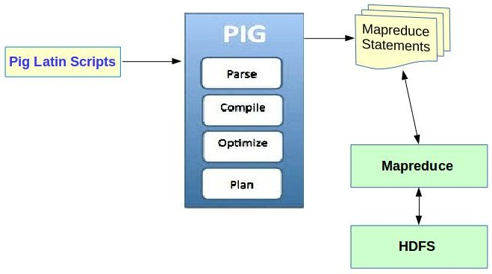
PIG ARCHITECTURE:

Slide 18
PIG ARCHITECTURE:
Parser: The Pig Scripts are handled by the Parser. The output of the parser will be a DAG (directed acyclic graph)
Optimizer:The logical plan (DAG) is passed to the logical optimizer, which carries out the logical optimizations such as projection and pushdown.
Compiler:The compiler compiles the optimized logical plan into a series of MapReduce jobs.

Slide 19
SQOOP:
Sqoop is a tool designed to transfer data between Hadoop and relational database servers.
Sqoop occupies a place in the Hadoop ecosystem to provide feasible interaction between relational database server and Hadoop’s HDFS.
Sqoop uses mapreduce to import and export the data.

Slide 20
THANK YOU

